Slide 1
The power of billions: data-driven innovation
Shirley Wu, Ph.D. | Director of Health Product @ 23andMe
Bay area Biotech-pharma Statistical Workshop
November 7, 2019

Slide 2

23andMe overview
Founded in 2006
Product helps individuals learn more about their health, traits, and ancestry through their DNA
Customers can choose to participate in online research, fill out surveys
10M+ kits sold, ~80% of customers consent to participate in research
The largest research platform with both genetic and phenotypic information

Slide 3



Unique interconnected business
Consumer
Providing direct access to learn about own genetics: health, traits, wellness, and ancestry
Empowering easy research participation
Research
Recruiting consenting participants from diverse ancestries and particular diseases of interest
Making discoveries that help Therapeutics and power new insights for customers
Therapeutics
Leveraging data to accelerate drug discovery
Addressing unmet medical needs and rare conditions
Notes:
From corp deck

Slide 4
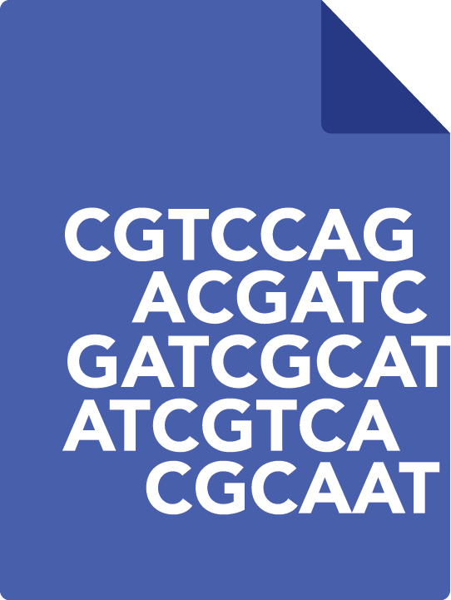



The 23andMe research platform is a new paradigm in biomedical research
+
+
=

Slide 5

Each research participant provides 500,000+ genotypic data points
TCGTGCATACGCATCAGTAT
TCGTGCATTCGCATCAGTAT
TCGTGCATACGCATCAGTAT

Slide 6

Participants contribute phenotypic data via online surveys
Disease diagnoses
Medication usage, side effects
Behavior and lifestyle
Environmental exposures
Family history

Slide 7

Engaged consumers create the foundation for crowdsourced science
7M+
customers consented to research
~50%
log in
quarterly
2B+
survey questions answered
75%
take ≥ 1 survey
Notes:
Modified from 10M+ customers to 7M+ customers consented to research per research portal numbers. Added quarterly log-in estimate (from metrics dashboard: https://metrics-23andme.appspot.com/logins/)

Slide 8
What's unique about 23andMe?

Slide 9
Sheer size of disease cohorts
19,111 with Parkinson’s
1,019,600 APOE e4 carriers
107,005
with cancer (non skin)
744,463 with depression
2,860,246 confirmed controls
2,954,800 confirmed controls
2,603,630 confirmed controls
2,177,226
confirmed controls
293,853
with asthma
115,622
with psoriasis
819,371 with CVD
11,425 with colorectal cancer
1,386,943
confirmed controls
2,806,720
confirmed controls
2,258,687
confirmed controls
2,945,316
confirmed controls
Notes:
From corp deck

Slide 10
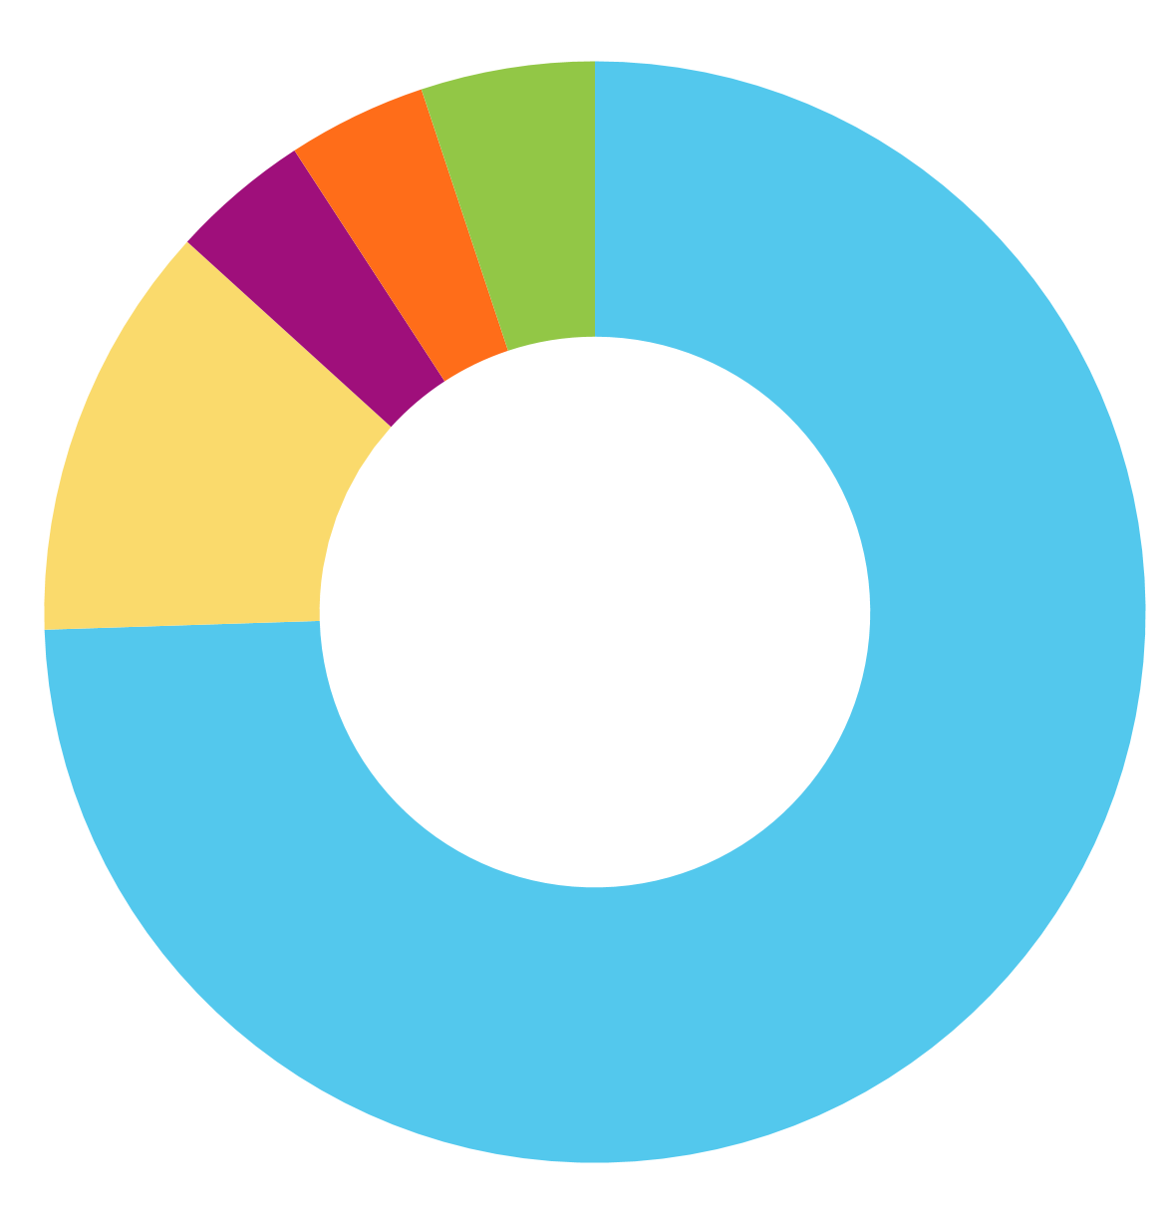
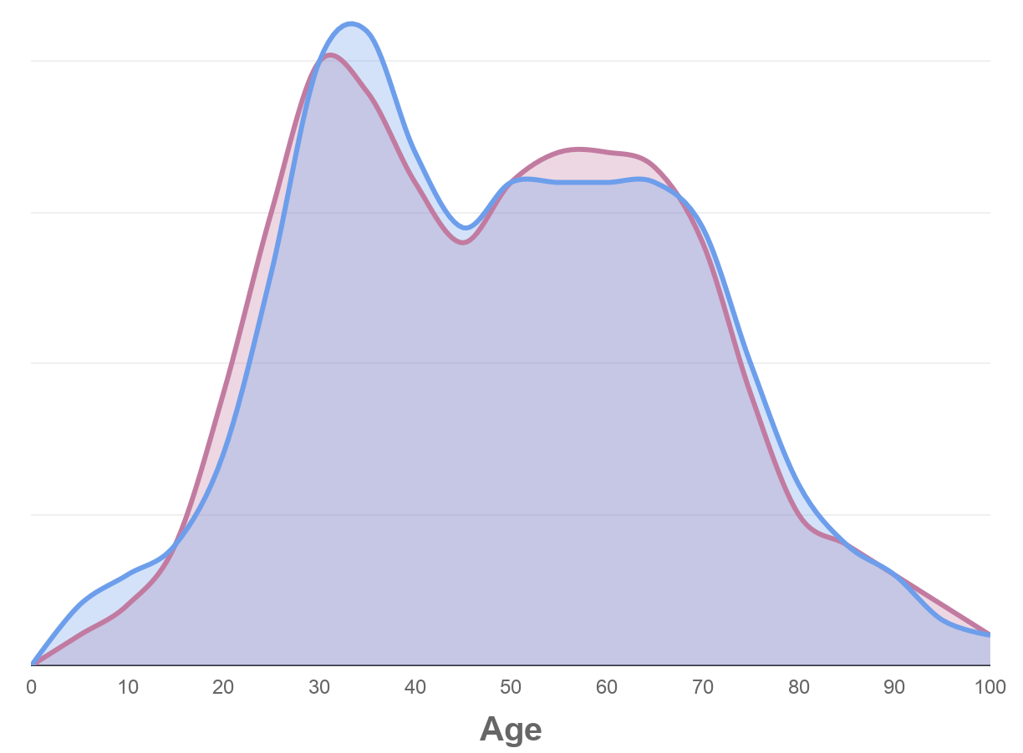

Database diversity and efforts to improve
73%
12%
4%
European
Latino
African American
55%
45%
4%
7%
Female
Male
East & South Asian
Other
Notes:
Our database is one of the largest for genotype and phenotype for people with African American and Hispanic and Latino ancestry.

Slide 11
Phenotypic breadth
Topics
Data sources
Longitudinal, high priority surveys
Health intake
Wellness
Stand-alone surveys and one-off questions (targetable)
Emerging data sources
Passive data
Lab values
Addiction
Autoimmune
Blood
Cancer
Cardiovascular
Cognitive
Diet
Drug usage
Drug efficacy
Drug side effects
Endocrine
Environment
Eyes
Food preferences
Gastrointestinal
Hair
Immune
Infection
Laterality
Lifestyle, sleep, sports
Longevity
Metabolic
Morphology
Musculoskeletal
Neurological
Personality
Pigmentation
Pregnancy
Psychiatric
Renal
Reproductive
Respiratory
Sensation
Sexual orientation
Skin
Teeth

Slide 12
What can you do with billions of data points?

Slide 13
Faster, better informed drug discovery
Detect genetic associations with disease and identify potential drug targets
Understand pathways, drug mechanism of action, and potential side effects to improve success rate
(Future) Precisely stratify patient populations to make clinical trials more efficient and successful
GWAS
Fine-mapping
PheWAS
Environmental data
Application of public data
Polygenic risk scores

Slide 14
GWAS and PheWAS at scale
Identifies SNPs associating with phenotype of interest
Identifies phenotypes that associate with SNP or gene of interest
rs23424590
Asthma
(GWAS)
rs8712300
(PheWAS)
Type 2 diabetes
rs3454055
Parkinson's disease
Diabetes
SNP X
rs4597906
High blood pressure
rs57565167
Hypertension
rs67565048
Pollen allergy
We regularly perform GWAS with millions of SNPs for each of hundreds of phenotypes relevant to human disease, and perform PheWAS on all 20,000+ protein-coding genes in the human genome.
Notes:
Adapted from Erik Karrer's slide from 2017 Genome Research Day

Slide 15
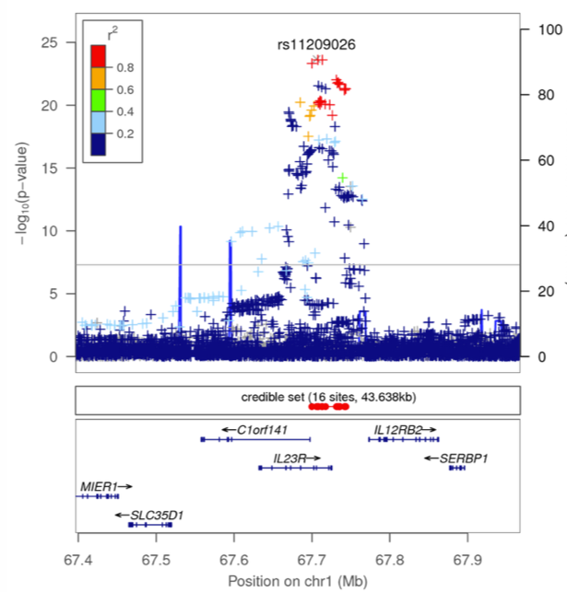
Use all the data!
Ulcerative colitis
Interrogate all available sources of data: external and internal, genetics, expression, biochemical, in vitro, in vivo etc.
Huge sample sizes result in narrow LD regions and sharp peaks, making fine mapping to associated eQTLs and identifying likely target much easier
Notes:
Adapted from Erik Karrer's slide from 2017 Genome Research Day after discussion with Kipper Fletez-Brant.
Red indicates SNPs that are in LD with each other, which appear to map to a specific gene (IL23R)
Sample sizes: when this analysis was done, ~11k for UC, 7.5k for Crohn's, 33.5k for psoriasis, roughly 500k controls. Now it should be a lot higher.
Many other companies are grappling with the problem of co-localization - how to find the gene that's responsible for the signal. We often can determine it much more easily because we can resolve the signals to much smaller regions.

Slide 16
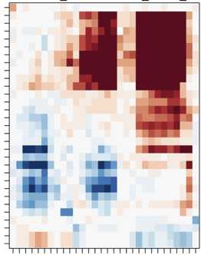
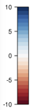
PheWAS for drug target analysis
Phenotype A
Phenotype B
Phenotype C
Phenotype D
Phenotype E
Phenotype F
Phenotype G
Phenotype H
Phenotype I
Phenotype J
Phenotype K
Phenotype L
Phenotype M
Phenotype O
Phenotype P
Clustering of related phenotypes can reinforce relevance of gene to disease biology and provide insight on potential therapeutic indications
Opposing directionality of SNPs across different phenotypes can reinforce drug concept MOA and can reveal potential side effects of modulating gene function
SNPs in Gene X
Notes:
Adapted from Erik Karrer's slide from 2017 Genome Research Day

Slide 17
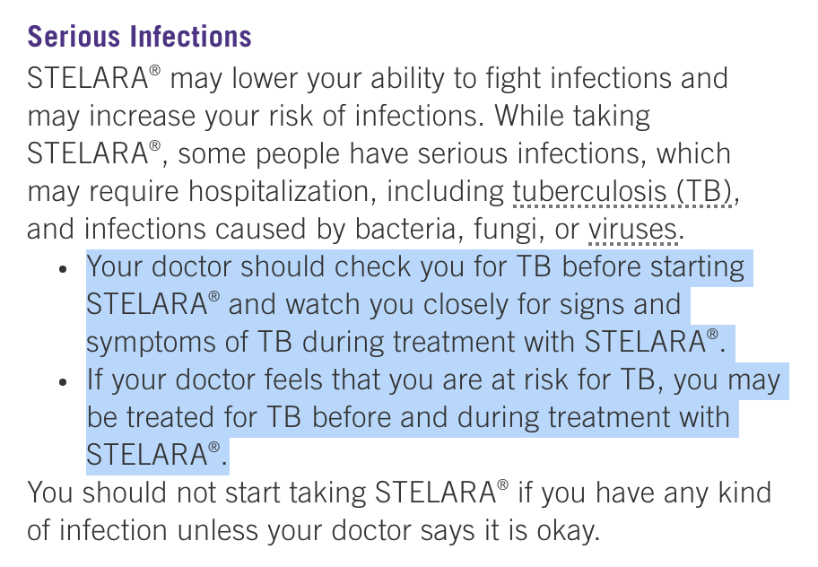
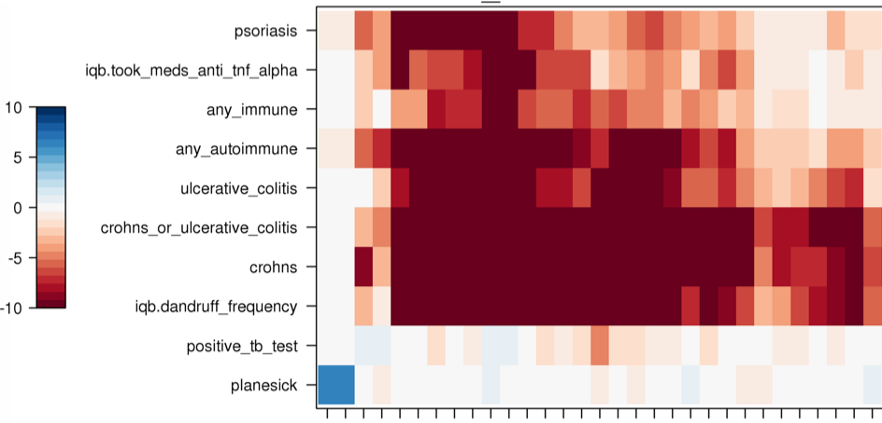
IL23R PheWAS Reveals Potential Side Effects of IL-23 Blockade
SNPs identified with opposite directionality for autoimmune and infectious disease (tuberculosis) – reveals potential for increased risk of infectious disease with IL-23 antagonism.
ustekinumab, an anti-p40 antibody (IL-12/IL-23 antagonist) contains warnings for infectious disease risk, with specific warning for tuberculosis:
ustekinumab drug safety information: https://www.stelarainfo.com/
Notes:
Adapted from Erik Karrer's slide from 2017 Genome Research Day

Slide 18
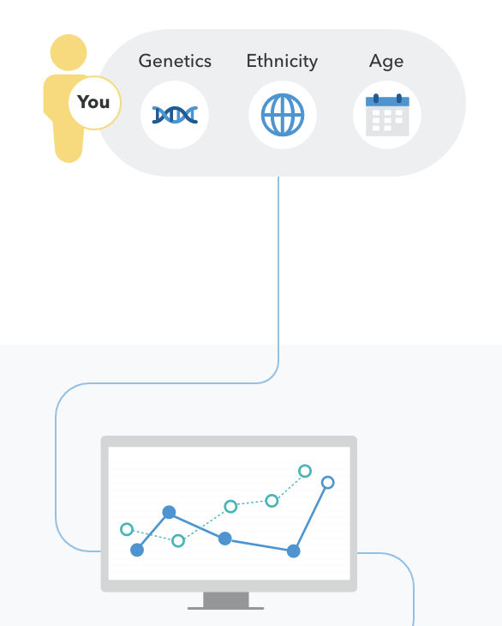
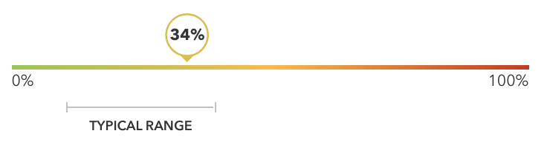
Polygenic scores
A Polygenic Score (PGS) captures the cumulative effects of many genetic factors, optionally with other factors like age, sex, PCs, and ethnicity, to predict how likely a person is to have a trait or condition.

Slide 19
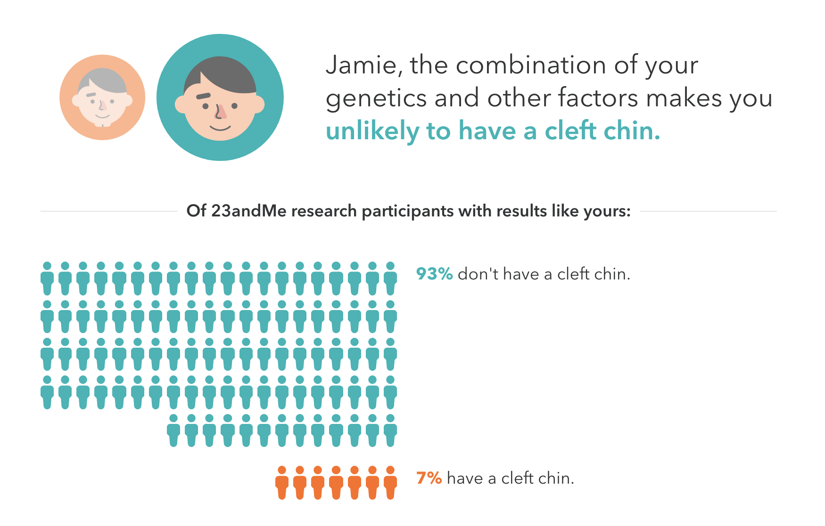
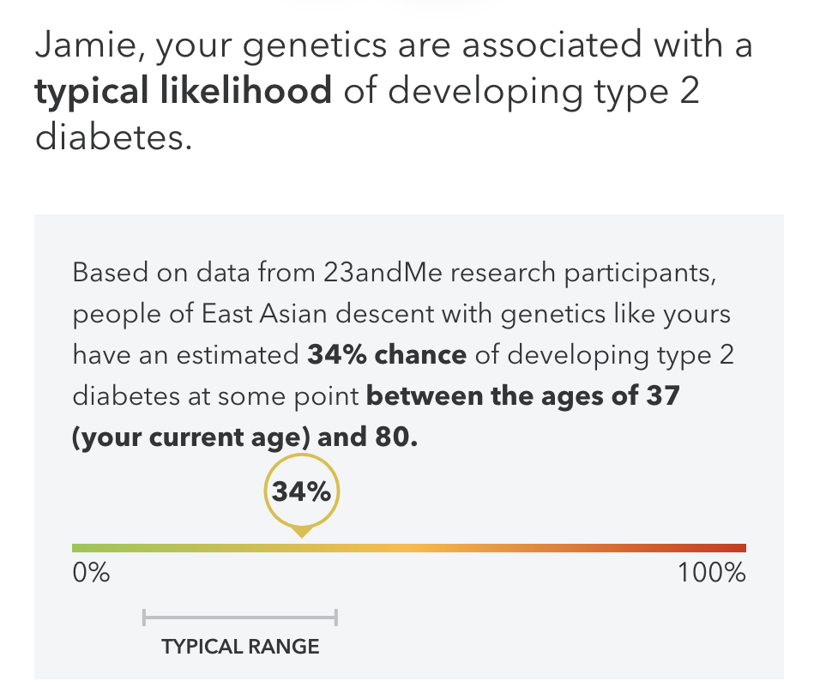
Delivering polygenic scores to consumers since 2015
2015
16 polygenic scores for common traits including cleft chin, sweet/salty taste preference, and male baldness
Genetic Weight score, including gene-by-environment analysis against lifestyle factors
2017
12 additional polygenic scores for traits including wake-up time, mosquito attraction, and dandruff
2018
Type 2 Diabetes polygenic score powered by data from more than 2.5 million research participants
2019
Notes:
T2D AUC:

Slide 20
Delivering polygenic scores to consumers since 2015
2015
16 polygenic scores for common traits including cleft chin, sweet/salty taste preference, and male baldness
All derived from 23andMe's research platform
Our polygenic scores now routinely use data from over 1M+ consented individuals
Genetic Weight score, including gene-by-environment analysis against lifestyle factors
2017
12 additional polygenic scores for traits including wake-up time, mosquito attraction, and dandruff
2018
Type 2 Diabetes polygenic score powered by data from more than 2.5 million research participants
2019
Notes:
T2D AUC:

Slide 21
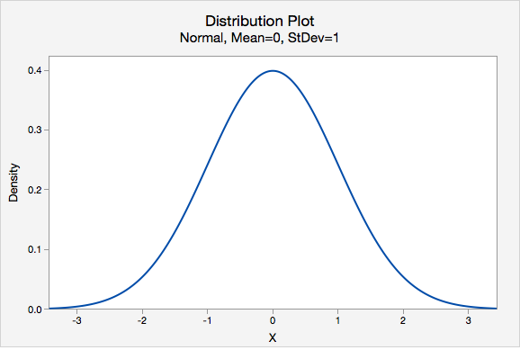
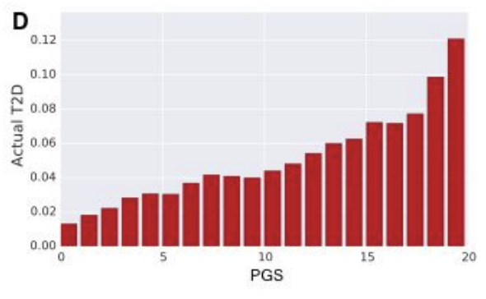
Polygenic scores for risk prediction
2.9x
# of people
N=176,630
PGS
https://research.23andme.com/wp-content/uploads/2019/03/23_19-Type2Diabetes_March2019.pdf
Notes:
Stratify people by risk, identifying people in the tails who have much higher or lower risk than average.

Slide 22
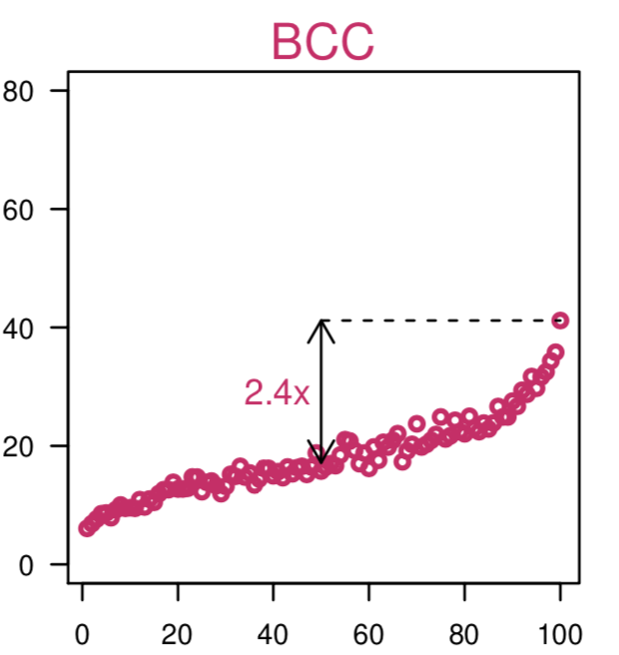
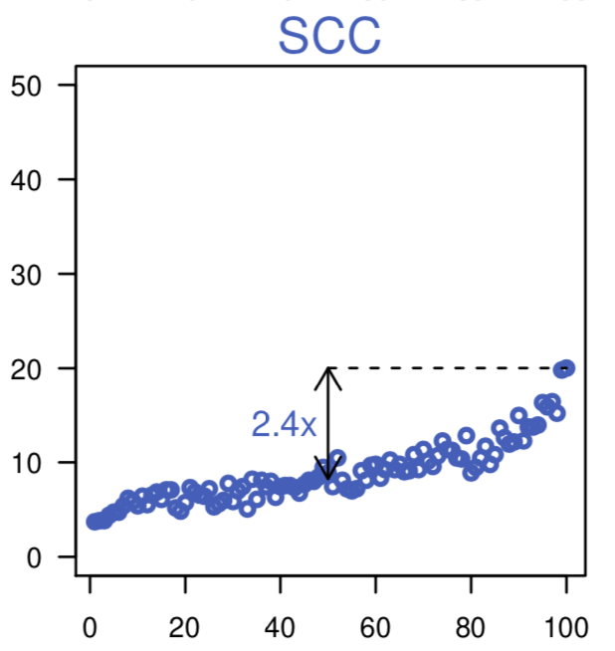
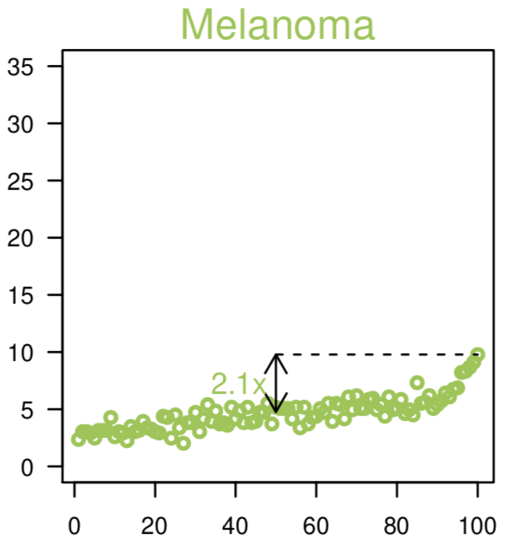
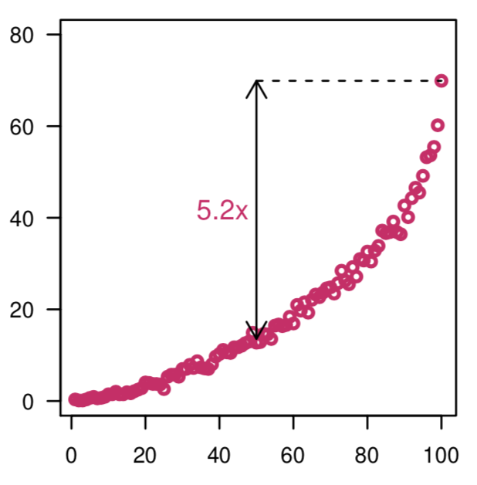
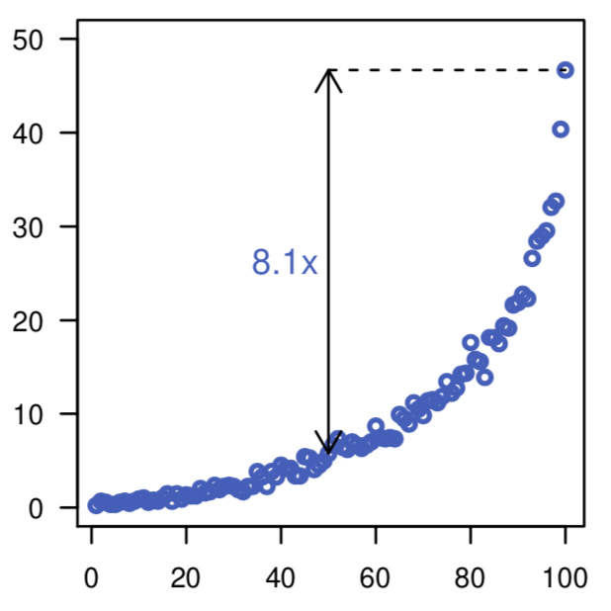
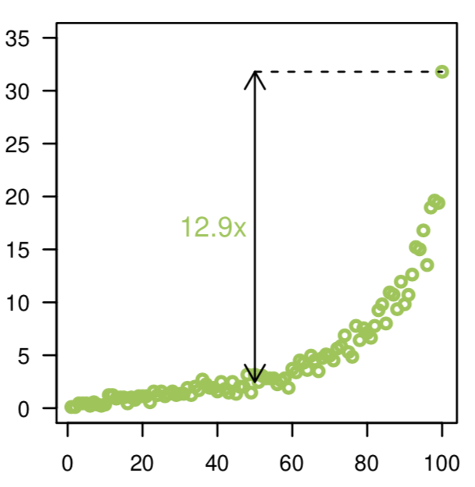
Including exposures improves stratification
Genetics only
Genetics + exposure
N=88,985
Manuscript in progress, preliminary data presented at American Society of Human Genetics 2018 meeting
Notes:
From discussion with Pierre Fontanillas
Chose to look at skin cancer because relatively genetic (pigmentation-related), but also highly dependent on a very simple environmental background (sun exposure-related)

Slide 23
Risk stratification can identify interesting sub-cohorts
Why do some individuals > 60 yo in the top risk band with high exposure not have skin cancer?
Why did some individuals in the lowest risk band with minimal exposure develop skin cancer in their 30s?
Melanoma prevalence by risk score percentile
Investigating either extreme can reveal novel biology
Finding protective effects especially attractive for drug development
Notes:
From discussion with Pierre Fontanillas
23andMe can get much more precise classification because our models can stratify using so many more variables. Identify people who are clearly different from what's expected. Plus we have SO MUCH DATA. Makes making PRSes so much better, we can create huge training sets and experiment with so many parameters, and still have a ton of data left to validate on.
Identify more promising drug targets. (example with obesity and people with clean arteries, 2 drug targets for CAD already in development based on this concept)
Get at novel biology.
We don't have sequencing data but we have lots of ability to collect non-genetic data and compute all the scores.

Slide 24
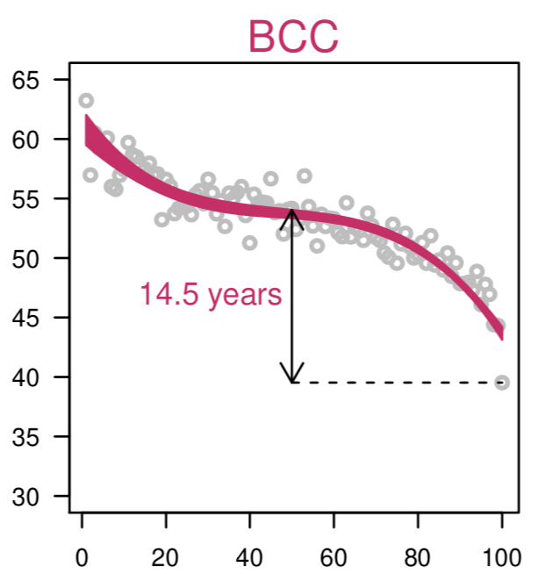
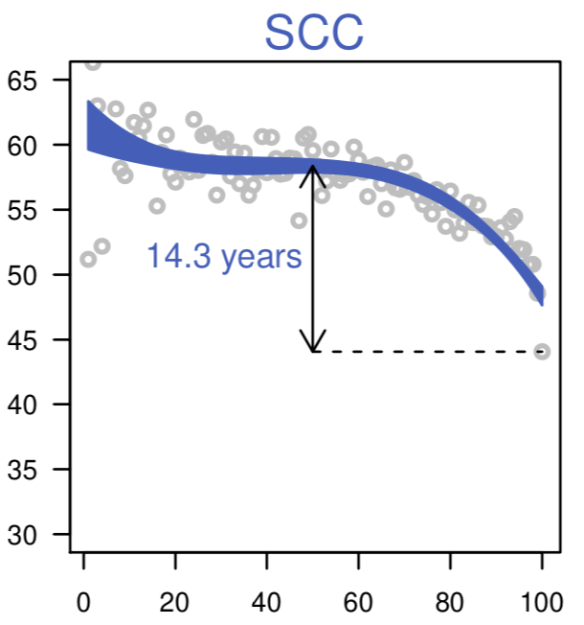
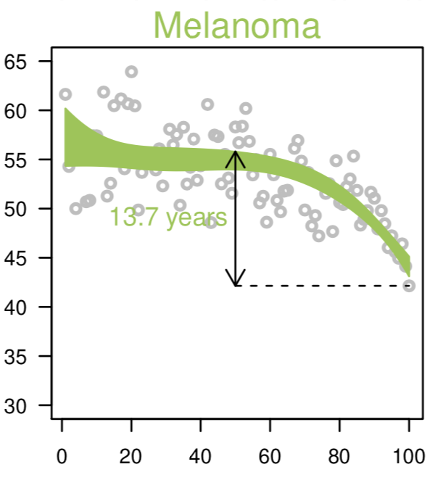
Risk stratification identifies interesting sub-cohorts
Age at diagnosis
Identifying fast or early progressors, or individuals with extreme risk profiles, can enable targeted recruitment and more efficient clinical trials.
Manuscript in progress, preliminary data presented at American Society of Human Genetics 2018 meeting
Notes:
From discussion with Pierre Fontanillas
Total disease risk score model minus demographics

Slide 25
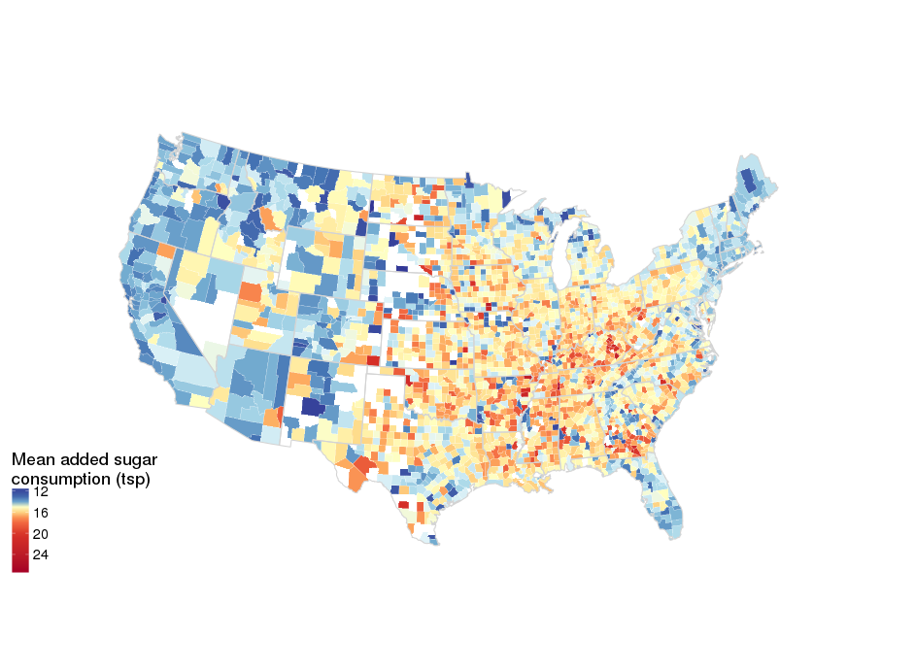
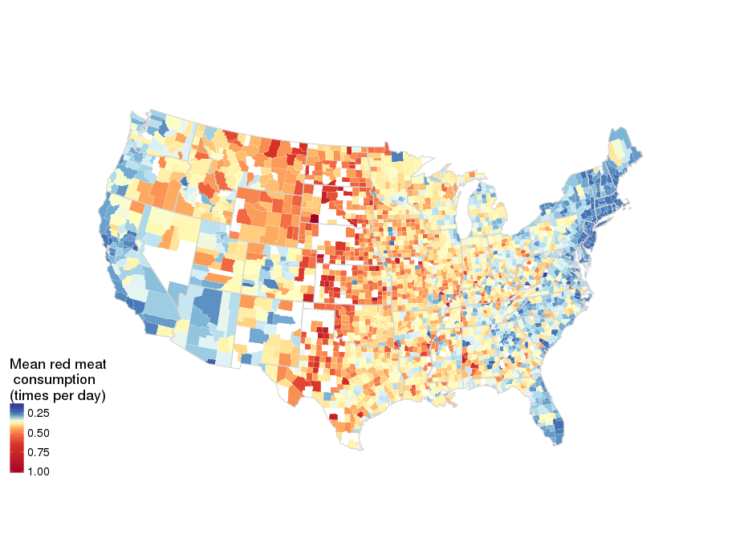
Detailed epidemiological data on behavioral phenotypes and health outcomes
Added sugar
Daily dietary habits in 23andMe customers by US county
Derived from a 23andMe administered NHANES-style survey,
N ~ 700,000, only counties with >5 respondents shown
Red meat
Notes:
Data maps from Briana Cameron, exported from research environment and suitable for external use

Slide 26
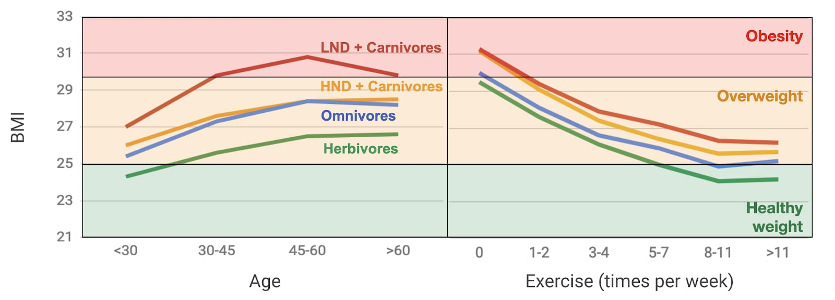
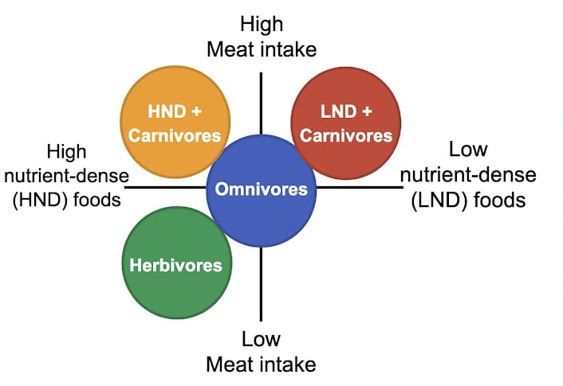
23andMe's data enable deeper analyses and insights into patterns of human behavior and health
Four diet types projected in the two main behavioral axes defining those types. Behaviors assessed via food frequency questionnaire in ~ 850,000 23andMe research participants.
https://blog.23andme.com/23andme-research/23andme-explores-dietary-habit-and-health-outcomes/
Notes:
Figure 1. Left graph represents the four defined diets projected in the two main behaviors axis (nutrient content of foods and meat intake). Right panel describes the nutritional differences between these diets, the dots represent the average response to the survey question: “How frequently do you eat this food?” Possible responses were: “not at all” (all dots empty), “1-2 times per week” (one filled dot), “3-6 times per week” (two filled dots), “once per day” (three filled dots) or “more than once a day” (all dots filled).
individuals who ate more fruits and vegetables — Herbivores — were more likely to have a BMI in the healthy range — between 18.5 and 24.9 as defined by the Centers for Disease Control and Prevention (Figure 4). However, without exercise, those individuals in the Herbivore group were still likely to be overweight. That said, looking at our data it may be even more difficult to maintain a healthy BMI if your diet is in one of the other three dietary categories HND + Carnivore, Omnivore and LND + Carnivore.

Slide 27
Future directions
Drug discovery:
Leverage environment and other non-genetic data to further understand biology and drug mechanism of action and potentially develop drugs that are more effective for people with certain exposures
Apply risk prediction to define precise cohorts that make clinical trials faster and more successful
Consumer products:
Improve prediction through more sophisticated integration of non-genetic factors
Provide actionable information about exposures to avoid, as long as we can reasonably establish causality
Deliver deeper insights into relatable behaviors and their relationship to outcomes to drive individual change
Notes:
From discussion with Pierre Fontanillas
Our current data hasn't shown a smoking gun, but we have enough power to start really probing at this.

Slide 28
Acknowledgments
23andMe research participants
23andMe Therapeutics team, including Computational Biology
23andMe Research team, including Data Collection, Statistical Genetics, and Research Ethics teams
23andMe Product, Product Science, and R&D teams

